Slide 1
Joshua & Jeanine
COVID-19 and Class

Slide 2
Big Question
How do COVID-19 deaths vary across different income levels across the United States?
How do COVID-19 deaths vary across different counties across the United States?

Slide 3
Ethical Considerations
Our dataset is limited.
In our dataset, we found that the data for reported COVID-19 cases/deaths did not exist for some counties
No data counties were excluded from our analysis
We analyzed median income levels by county and associated it with COVID cases
Does not reflect on an individual city or community basis

Slide 4
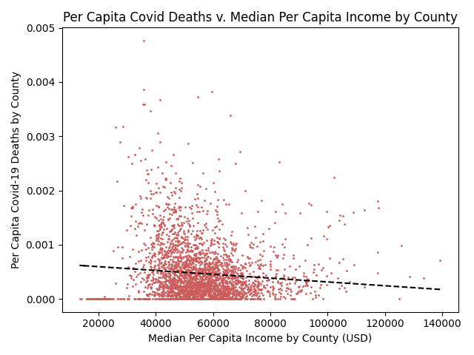
Analysis / Visualization

Slide 5
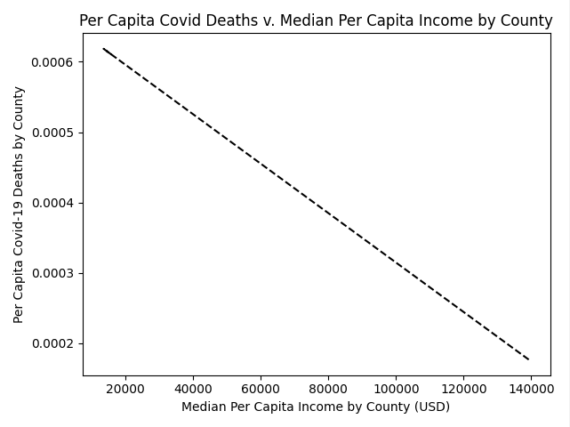
Analysis/Visualization

Slide 6
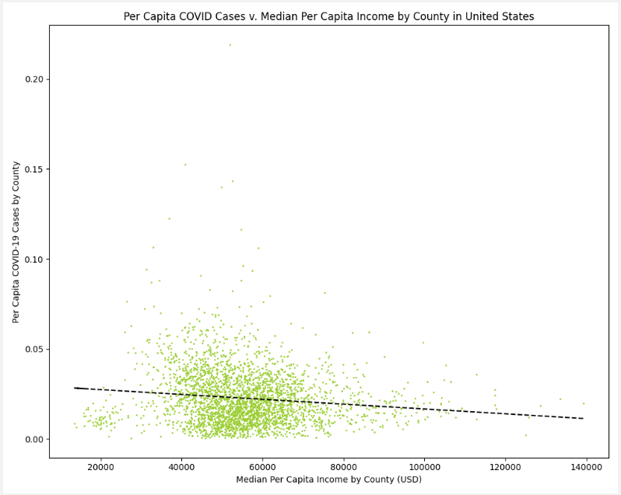
Analysis/Visualization

Slide 7
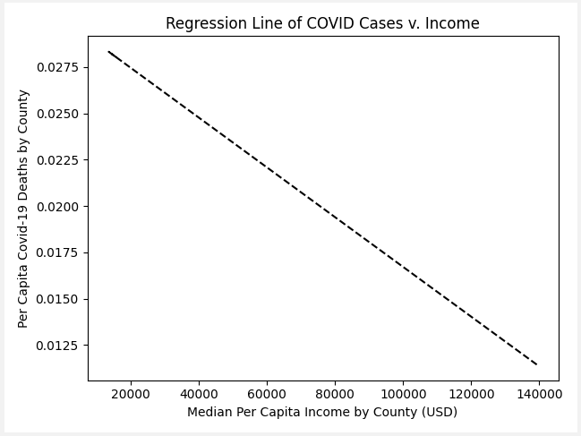
Analysis/Visualization

Slide 8
Last Mile / Future Work
Find a more granular dataset to view how socioeconomic class affects COVID-19 treatment and cases
Visualize disparities in COVID-19 data across different racial/ethnic groups (per CDC categories)
Hispanic/Latinx
Black
White
Native American

